Slide 1
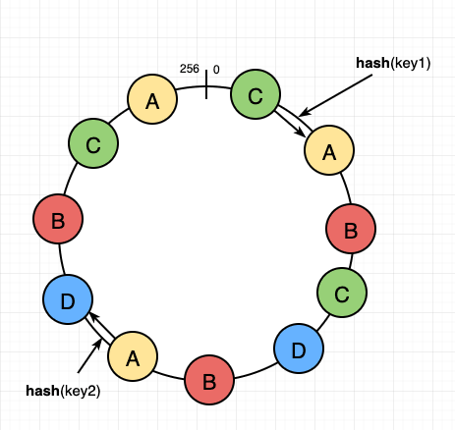

Lab 04 - Sharding
https://bit.ly/41FrCyJ

